Slide 1
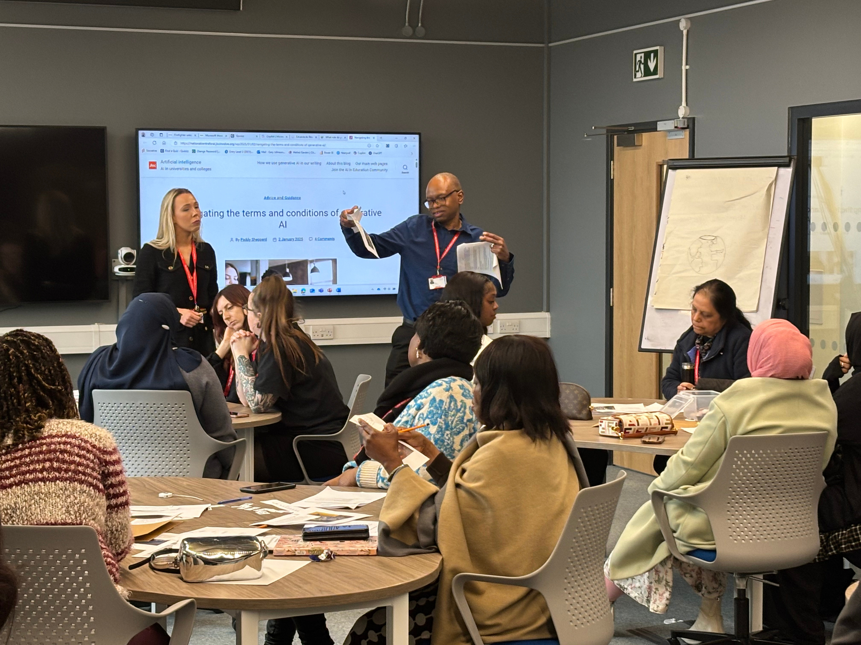

INNOVATE TO ELEVATE
USING TEACHER EXPERIMENTS TO SHARE GOOD PRACTICE, DRIVE STANDARDS AND ENCOURAGE INNOVATION
CLAUDIA BOERESCU, DIRECTOR OF TEACHING

Slide 2

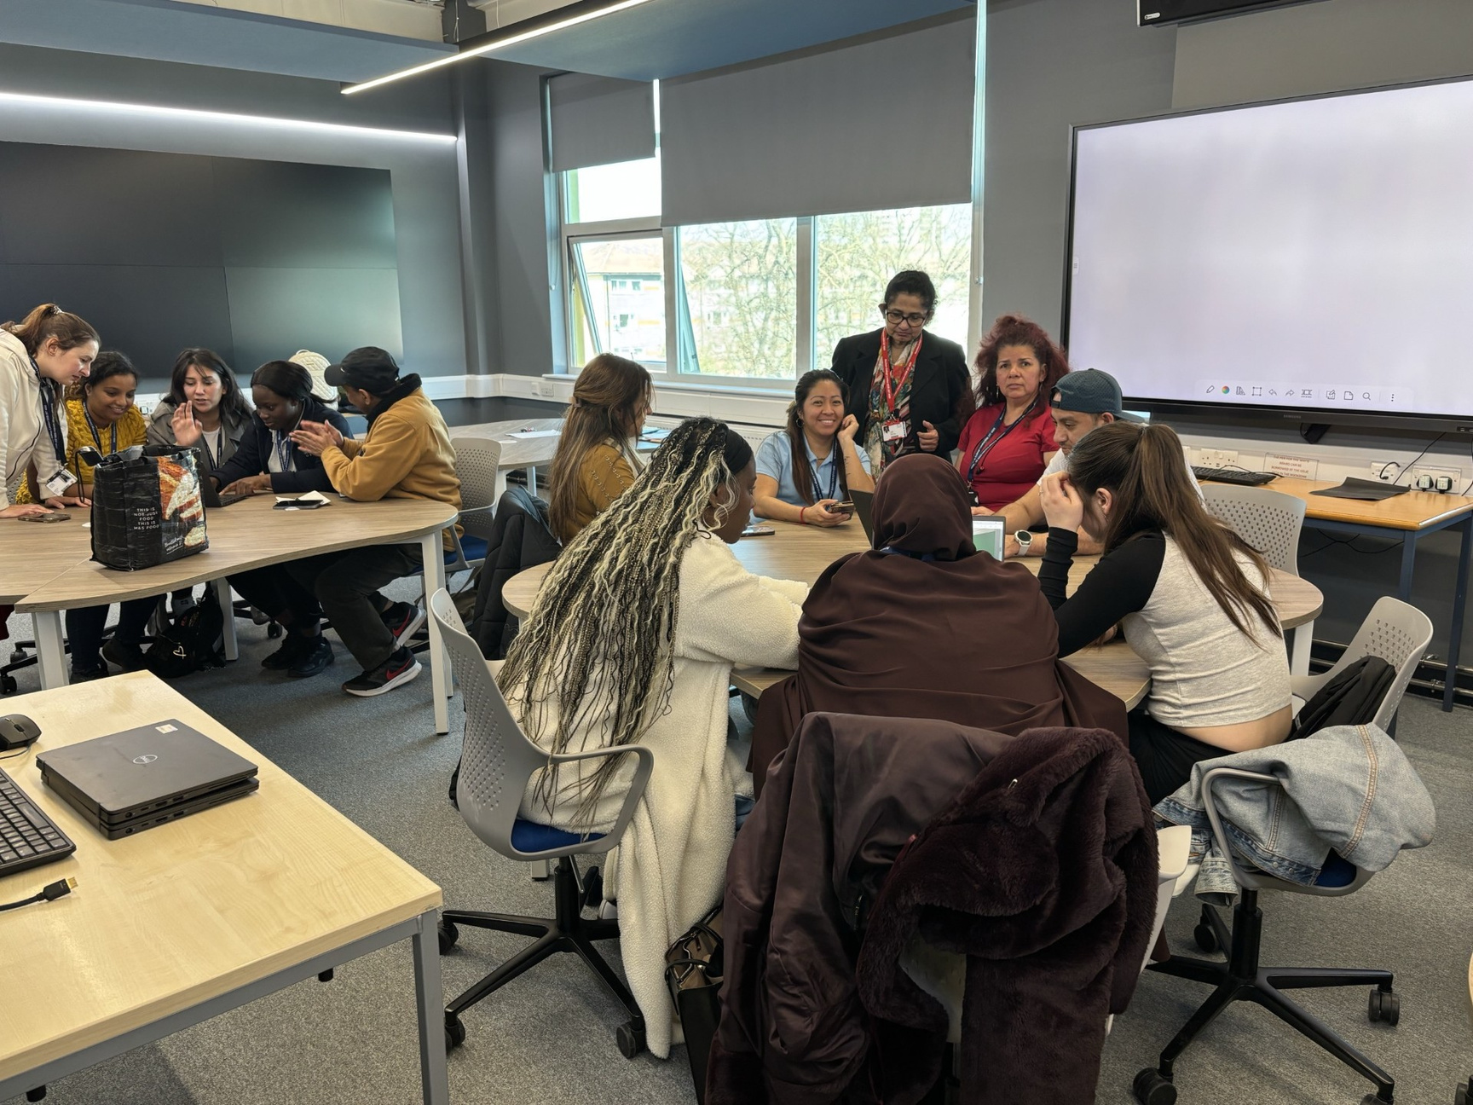
1
PURPOSE
2
IMPORTANCE OF TEACHER-LED INNOVATION
AGENDA
3
THE JOURNEY AT NEWHAM COLLEGE
4
THEMES OF EXPERIMENTS
5
IMPACT ON TEACHERS
6
IMPACT ON STUDENTS
EMBEDDING A CULTURE OF INNOVATION
7

Slide 3
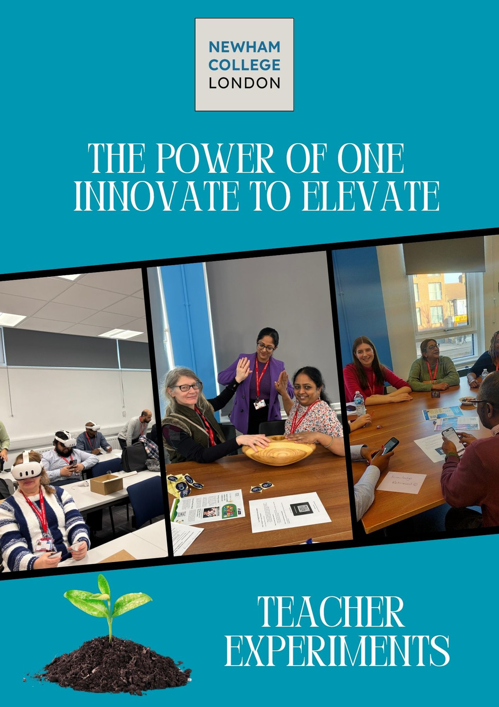

PURPOSE
Session Aim: To explore how teacher-led experimentation has driven transformation at Newham College
The growth mindset fuels this development, reminding students and educators alike that the zone of proximal development is a valid and powerful place to be.
Why teacher-led experimentation?

Slide 4

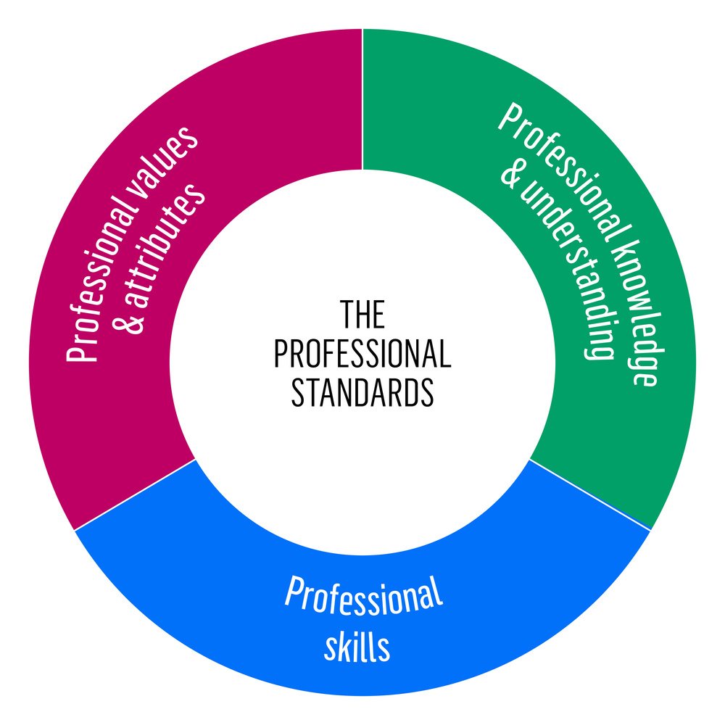
IMPORTANCE OF TEACHER-LED EXPERIMENTS
“Teachers are more likely to implement and sustain effective practices when they are involved in selecting, adapting, and evaluating the approaches they use.”
— EEF: “Effective Professional Development” (2021)
Link to professional standards (1,9,10), modern frameworks and innitiatives (Education 4.0, ESD, Digital Capability, LSIP priorities);
Teachers best know their learners and context;
An opportunity to reflect on and develop their pedagogical content knowledge;
Bottom-up innovation supports:
  Ownership
  Authenticity
  Sustainable professional growth

Slide 5
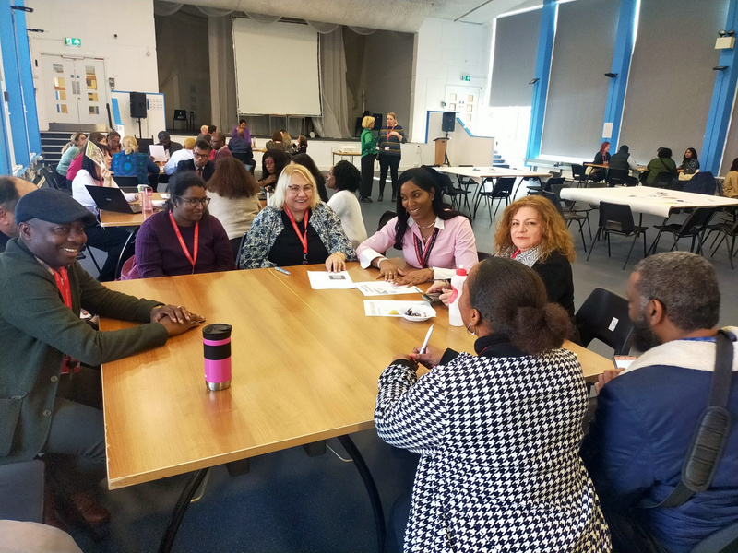
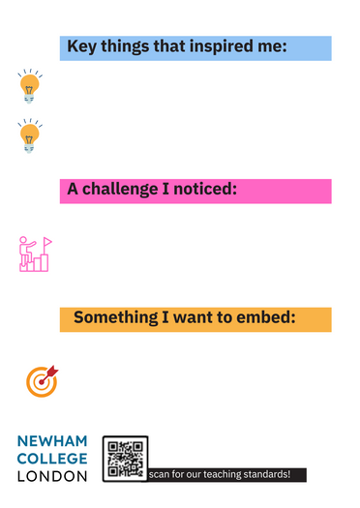


THE JOURNEY
LAUNCH TERM 1
DEVELOPMENT: TERM 1-2
PEER OBSERVATION: TERM 3
CLOSING THE LOOP
  Asynchronous resource, focusing on launch of experiment and links to PCK - Padlet
  Launch of self-reflection against PS, ending in reflection, choice of experiment and link to frameworks;
  Link to observation focus (College IP) via observation training.
  Observation feedback (coaching conversations)
  Showcase of weekly newsletters
  CPD event: learning market event and engagement pods: refelction on impact and next steps.
  Experiment focus;
  Launch of CPD linked to peer observation guide (Edpuzzle) with focus on peer coaching
  Teacher pairing
  Use of observation cards uploaded on Padlet
  End of year round table talk event with showcase of experiments.
  Reflection on next steps

Slide 6
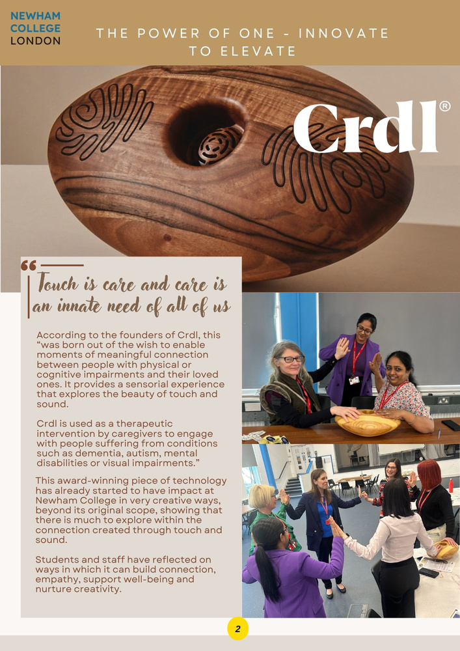

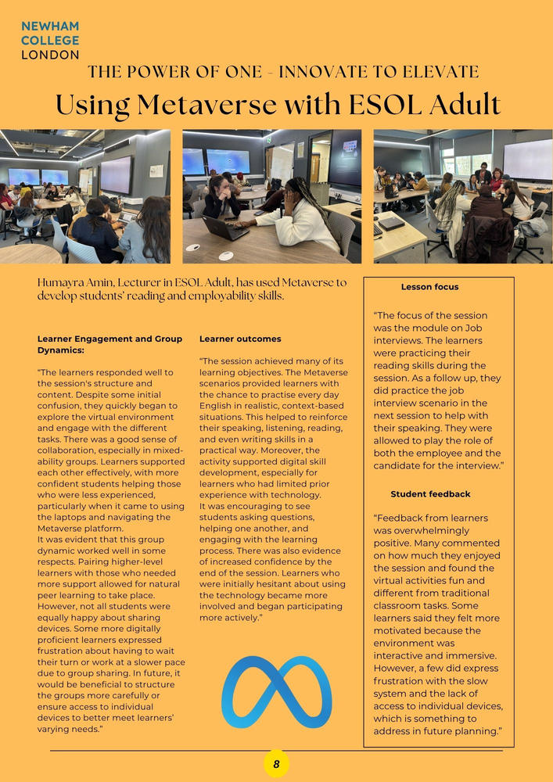
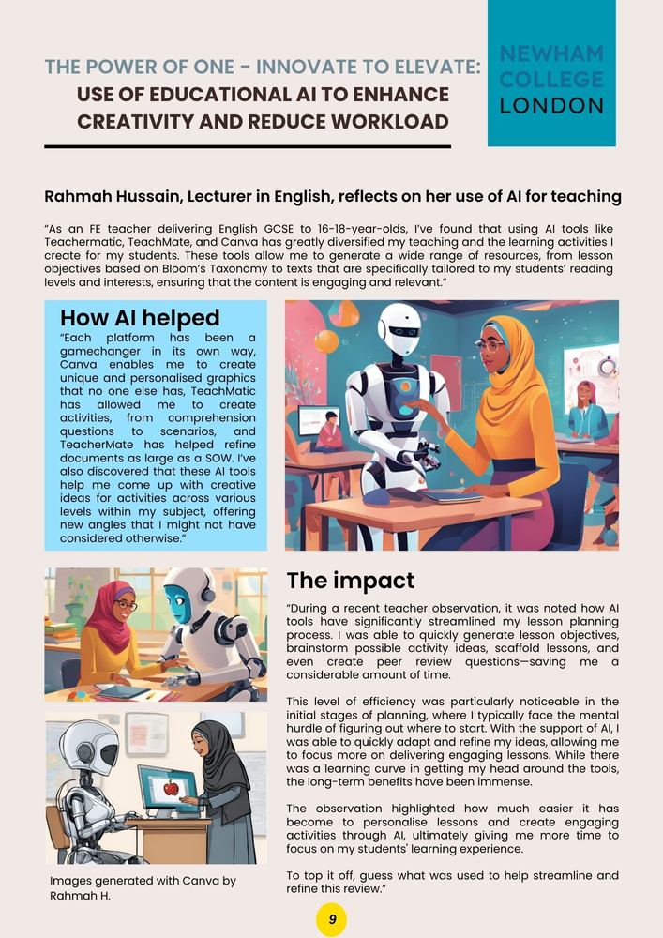

1. Enhancing Learning through Digital Innovation
  Crdl in Art, Health Science and CPD
  CLO3D in Fashion – virtual design & reducing waste - ESD link
  Metaverse in ESOL – job interviews in immersive environments
  AI tools for creativity and workload reduction (Teachermatic, Canva)
THEMES
EEF 2021: Technology can accelerate learning when aligned with pedagogy.

Slide 7
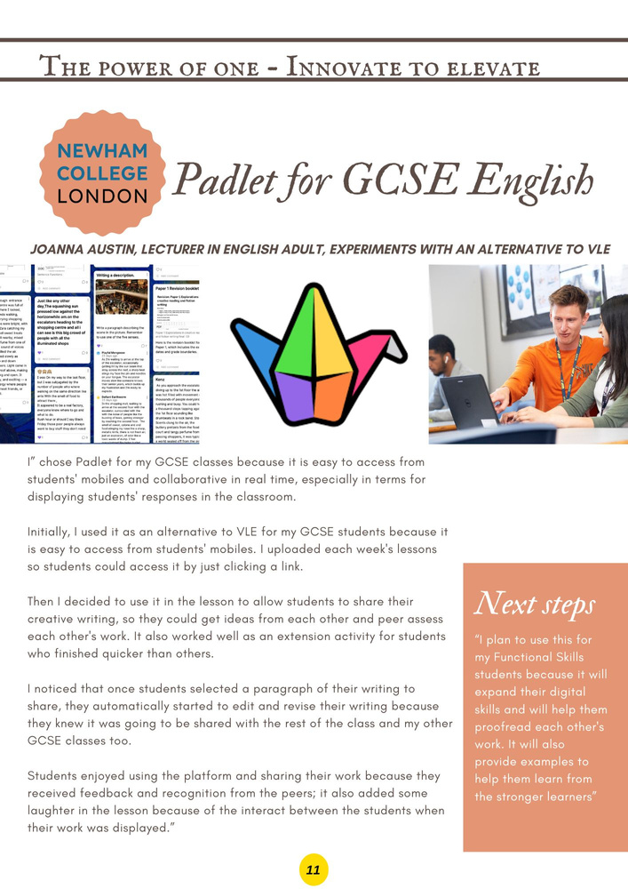
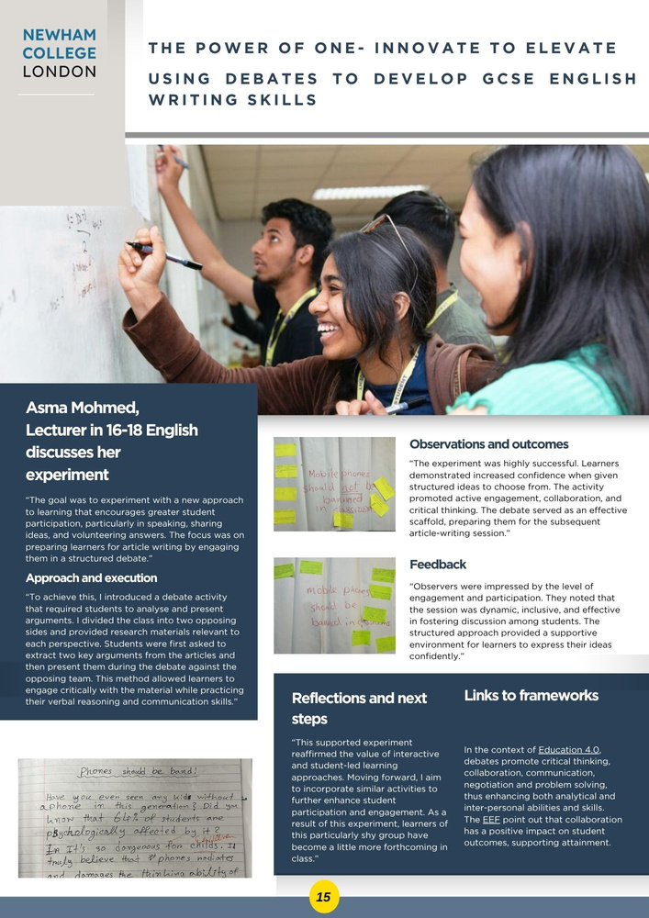
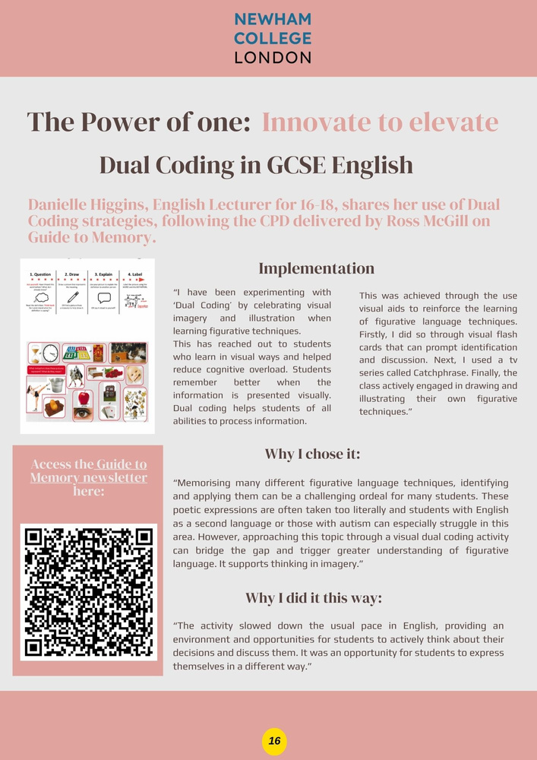
2. Developing learner voice & preparing them for exams- GCSE
THEMES
  Padlet in GCSE English – peer feedback, self-study
  Debates to develop writing – student-led, scaffolded critical thinking
  Dual Coding in GCSE English

Slide 8
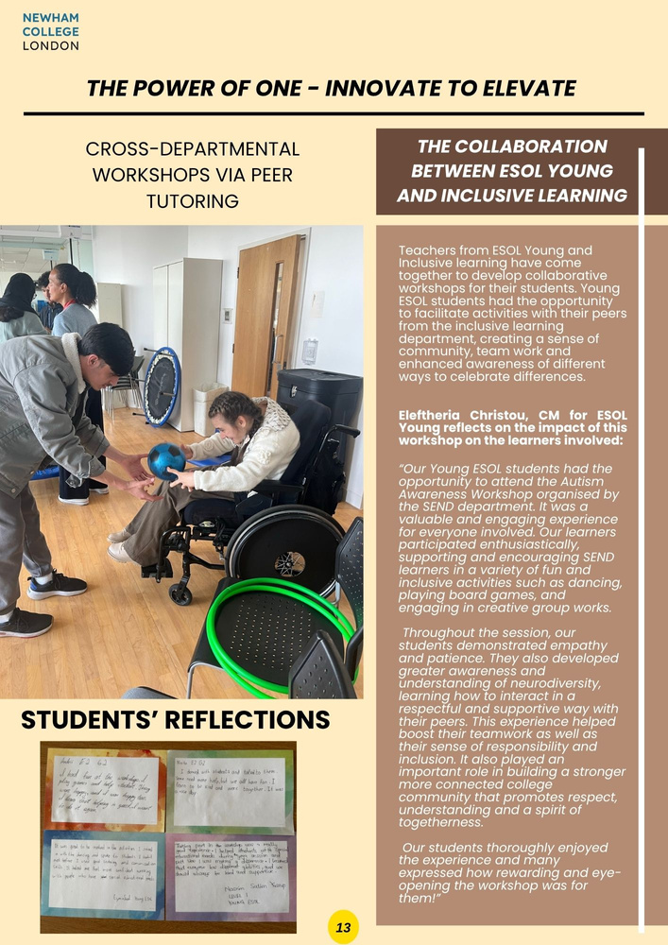
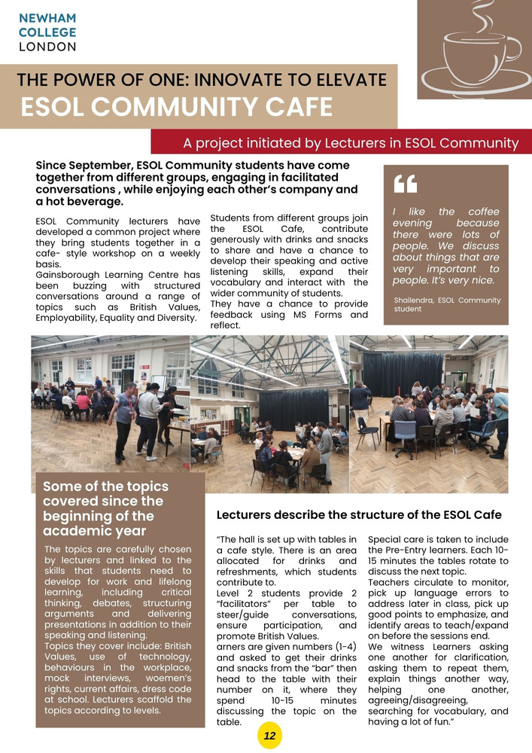
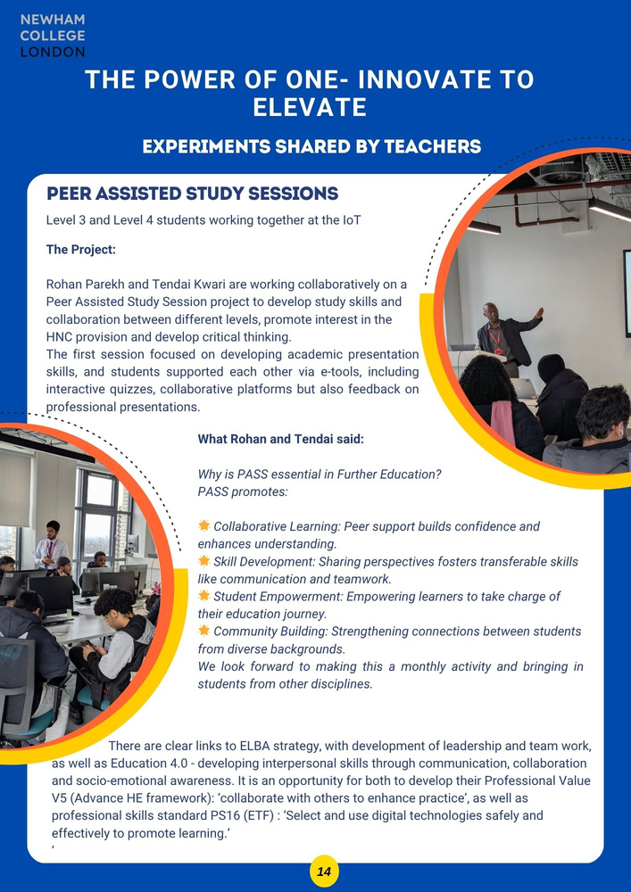
3. Community, Inclusion and Belonging
THEMES
Evidence-based practice (Hattie, 2001- Cooperative learning has an effect size of 0.53)
  Cross-departmental peer tutoring (ESOL & Inclusive Learning)
  ESOL Community Café – structured discussions, Pre-Entry included
  Peer-Assisted Study Sessions (PASS) – collaboration between L3/L4

Slide 9
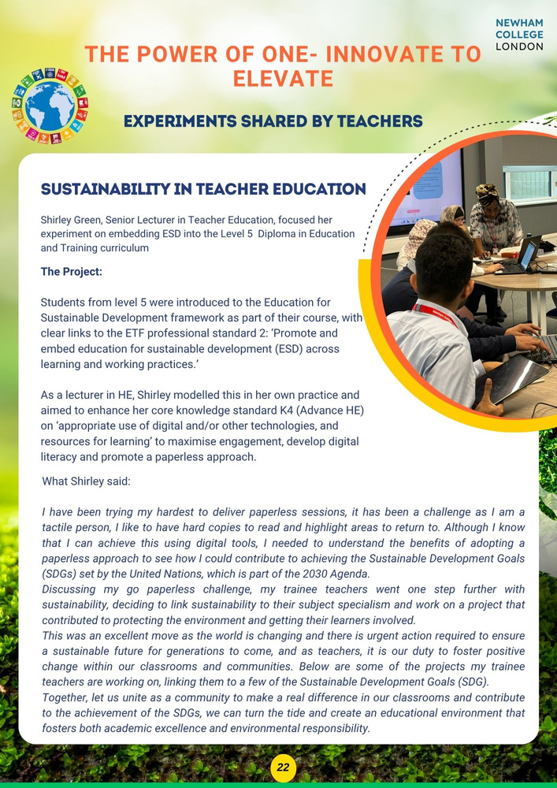
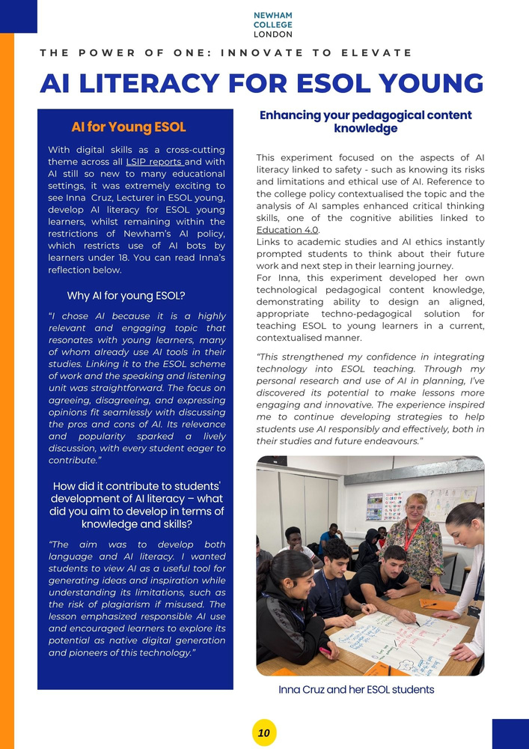
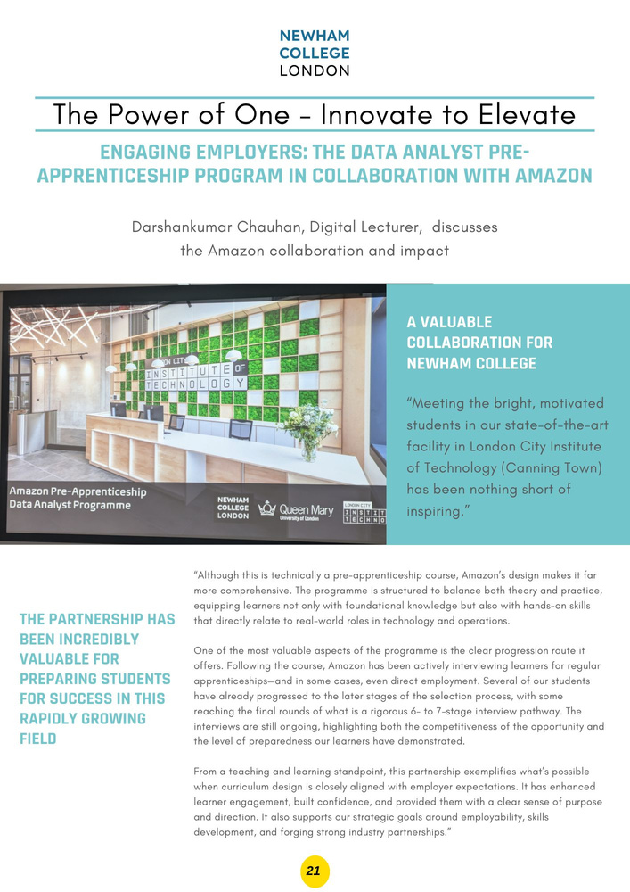
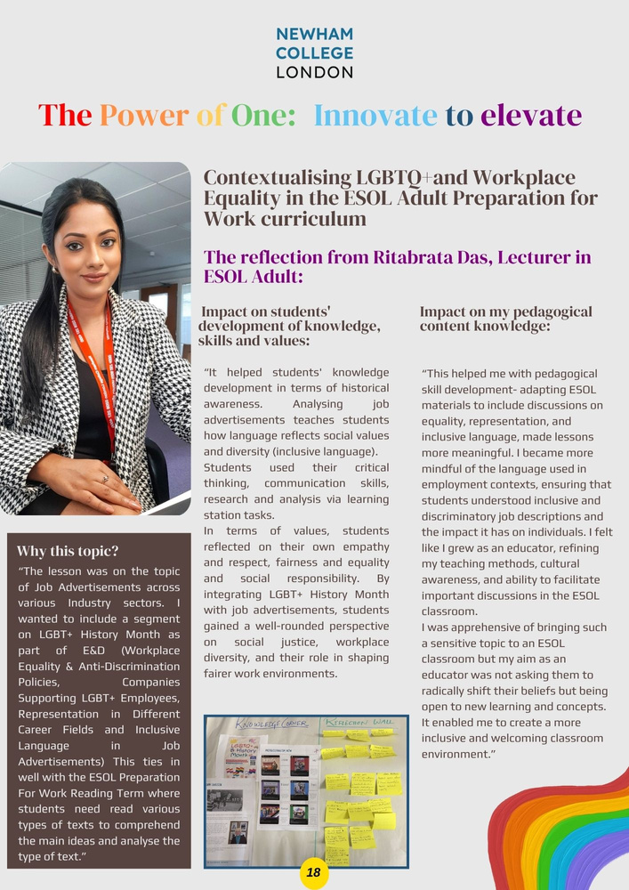
4. Embedding Elements
THEMES
  Sustainability in teacher education – SDG-aligned projects
  AI literacy in ESOL Young
  Partnerships with employers - Amazon
  Contextualising LGBTQ+ in the workplace in ESOL adult classes

Slide 10
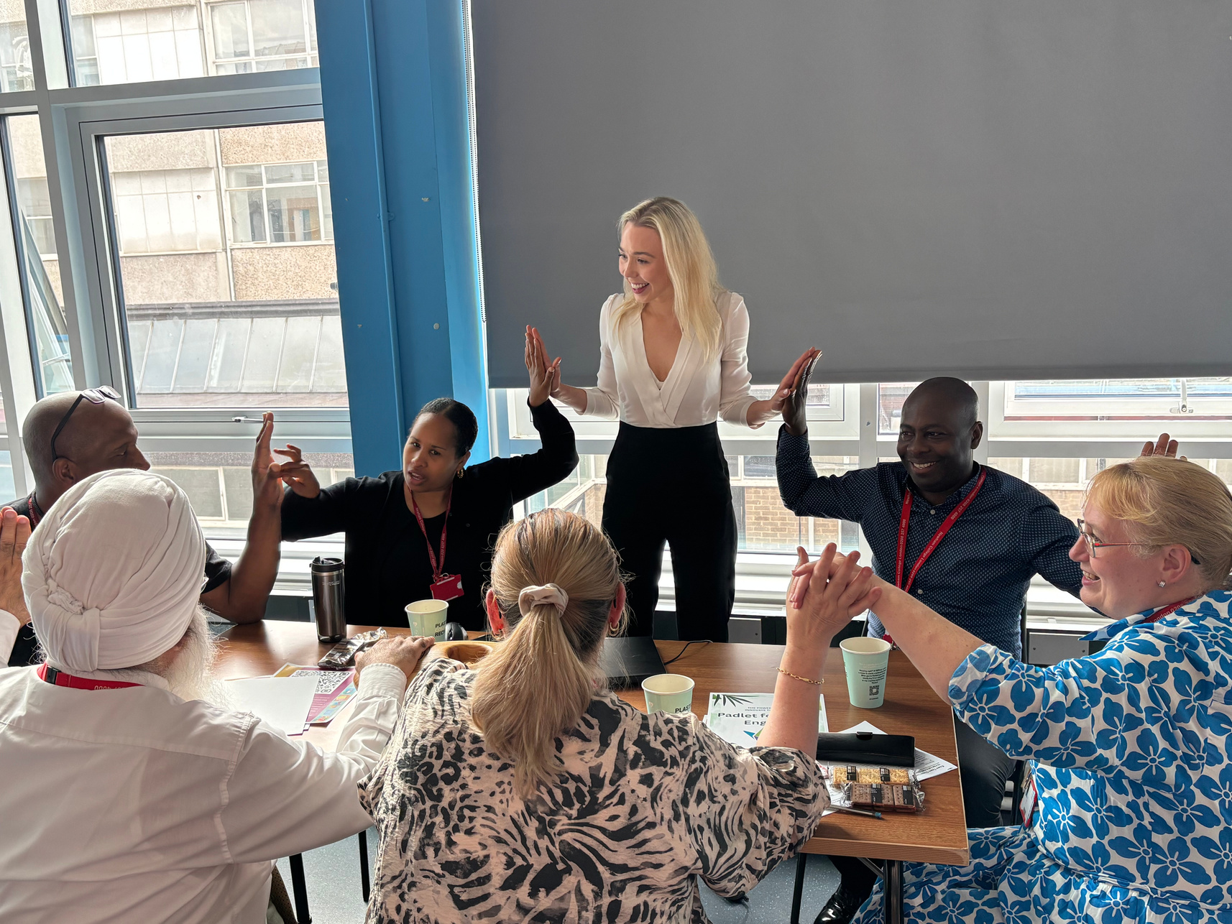
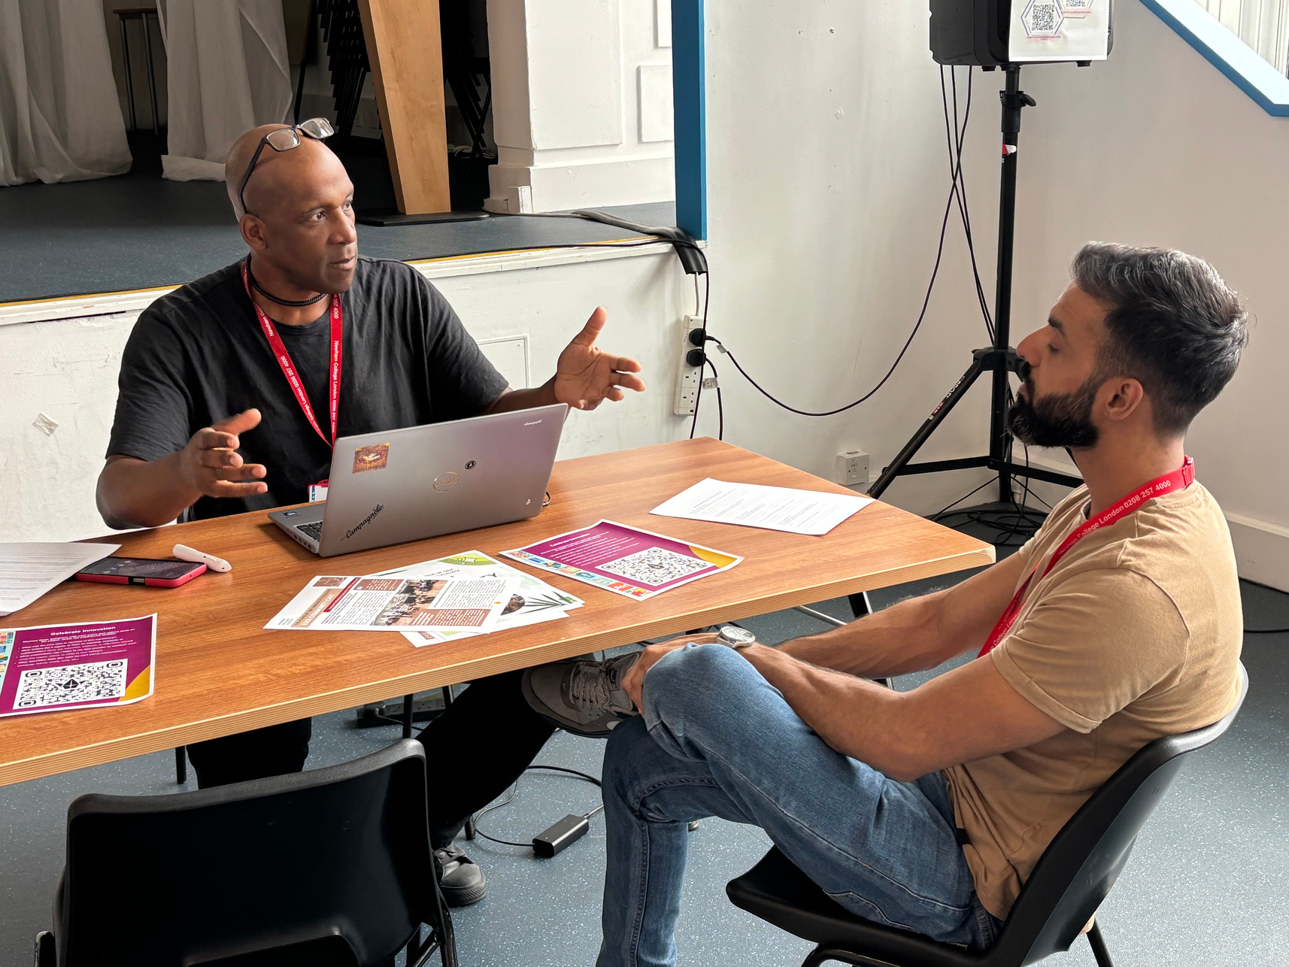



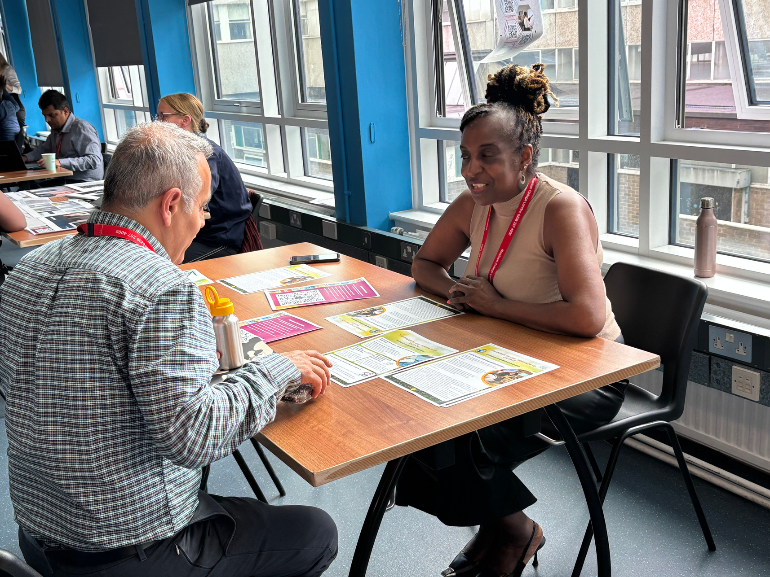
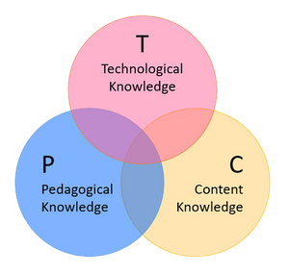
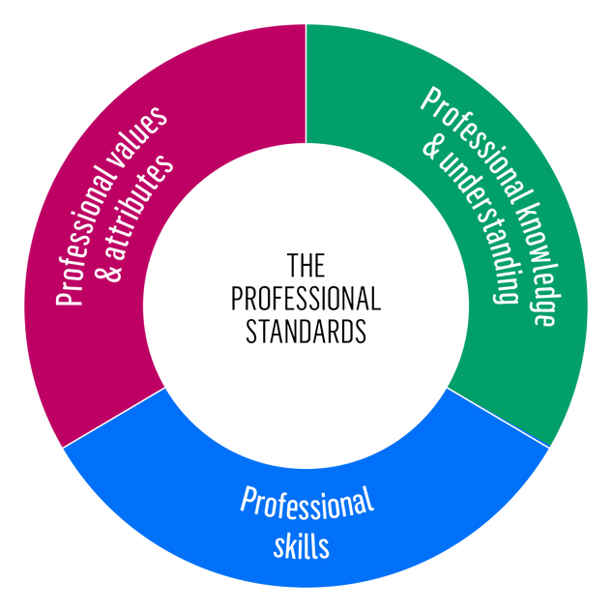
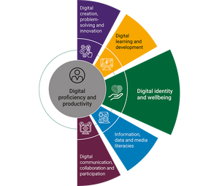


IMPACT ON
TEACHERS AS DESIGNERS
TEACHERS
RISK-TAKING, EXPERIMENTATION, CREATIVITY
Those who understand, teach. (Schulman, 1986)
PK
PCK
CK
AUTONOMY, OWNERSHIP, LEADERSHIP, REINFORCED PROFESSIONAL CONFIDENCE AND COLLABORATION

Slide 11
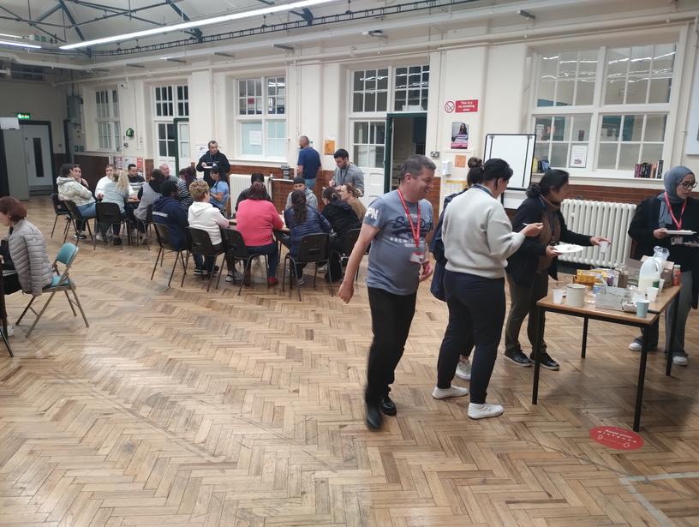
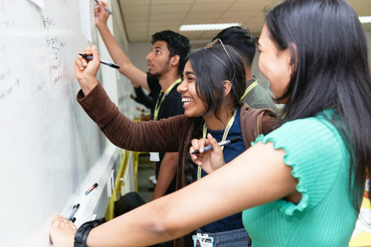
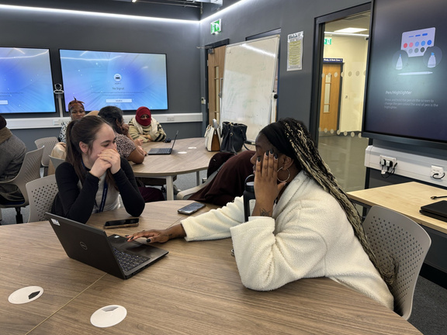
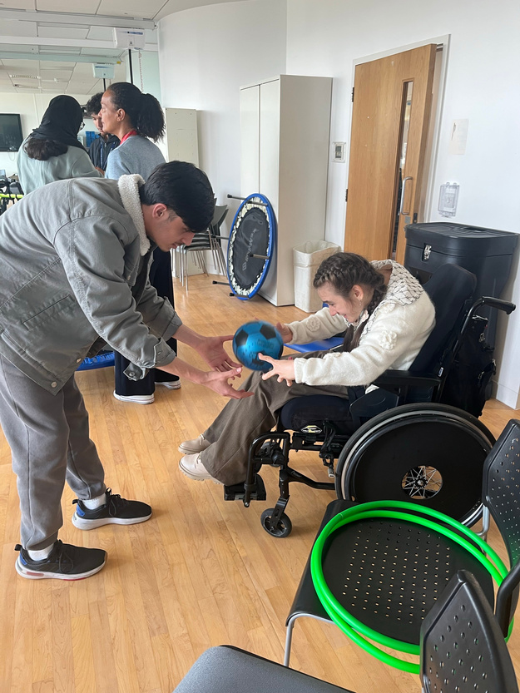




INCREASED ENGAGEMENT, AGENCY,AND PEER LEARNING​
IMPACT ON
STUDENTS
CONTEXTUALISED, REAL-WORLD LEARNING​
We can only develop autonomous learners through autonomous teachers. We simply cannot say we want happy, healthy, resilient, independent, confident, creative learners if we don’t enable those same characteristics in educators. (Rossa, AoC, 2023)
CO-CONSTRUCTION OF LEARNING EXPERIENCES
BELONGING AND INCLUSION

Slide 12
EMBEDDING A CULTURE OF INNOVATION (KEEP Framework, EEF, 2025)
Puroposeful and repeated practice to maintain focus
4. DEVELOP PRACTICE
Wider newsletter, whole college networking event and showcase, use of reflection tools (cards, padlet, forms)
Opportunities to develop
3. FOCUS ON EXECUTION
Coaching via observations, peer coaching and peer observations, peer support via learning market events.
Keeping motivation
2. PROMOTE ENGAGEMENT
Motivation is built through coaching, recognition through newsletters and showcase, and opportunities to lead CPD
  BUILD KNOWLEDGE
CPD
Launch of Power of One, reflection tool for development of PCK, links to frameworks

Slide 13
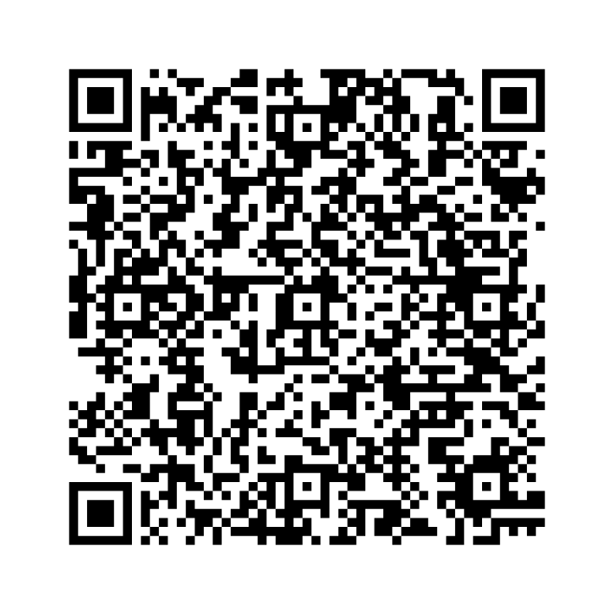
FUTURE DIRECTIONS
ACCESS THE FULL NEWSLETTER HERE:
For educators: What is one small pedagogical question you’re curious to explore — and what might your own experiment look like? How will it develop your pedagogical content knowledge?
For leaders: How would you develop a similar approach in your setting?

Slide 14
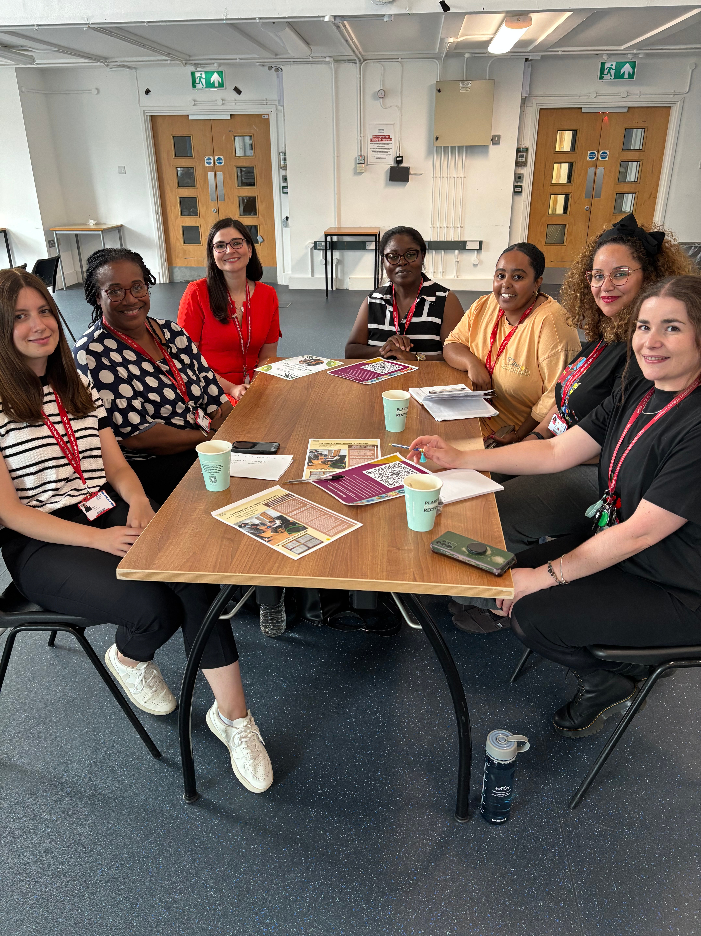
THANK YOU

