Slide 1

Coaching
How does it link to Professional Review and Self Evaluation?
Sue Atkinson – Headteacher John Taylor Free School

Slide 2
Context Information
Founding Headteacher – provided the opportunity to think differently about systems/ structures
Have been coaching for nearly 20 years
Qualified Level 7 Senior Leader and Executive Coach
JTFS has 1350 students Year 7 – Year 13

Slide 3
Coaching in Education
“The art of facilitating the performance, learning and development of another”
(Downey, 2003:21)
“Unlocking people’s potential to maximise their own performance”
(Whitmore 2009:11)
“..a human development process that involves structured, focused interaction and the use of appropriate strategies, tools and techniques to promote desirable and sustainable change for the benefit of the coachee and potentially for other stakeholders”
(Cox, Bachkirova and Clutterbuck 2014:1)

Slide 4
Definition of Coaching
A one to one conversation that focuses on the enhancement of learning and development through increasing self awareness and a sense of personal responsibility, where the coach facilitates the self-directed learning of the coachee through questioning, active listening and appropriate challenge in a supportive and encouraging climate
(van Nieuwerburgh 2012)

Slide 5
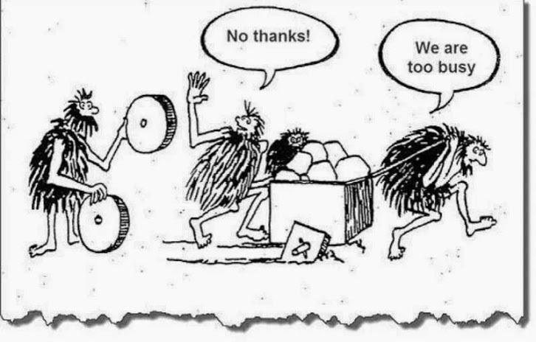

Slide 6
It isn’t always easy to get the balance right
Teaching
Counselling
Coaching
Mentoring

Slide 7
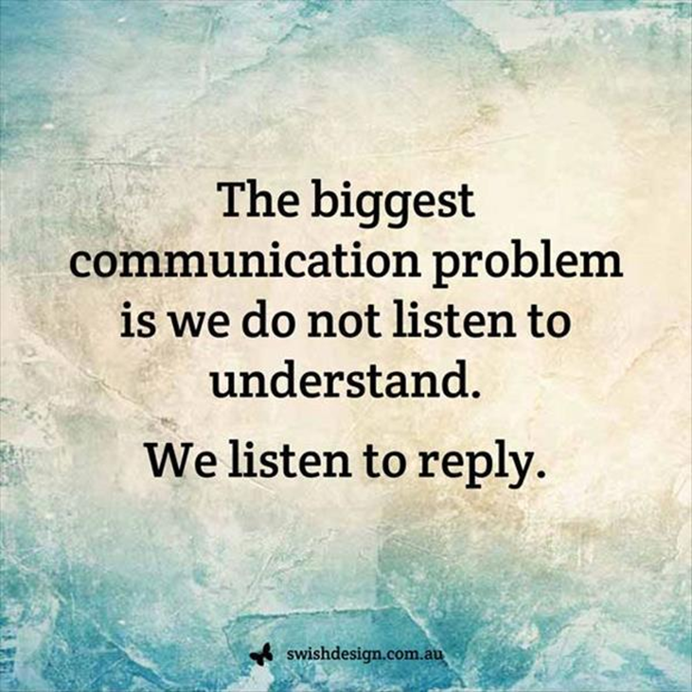
Coaching Models
GROW (TH)
CLEAR
BASIC
Instructional
OSKAR
Solution Focused

Slide 8

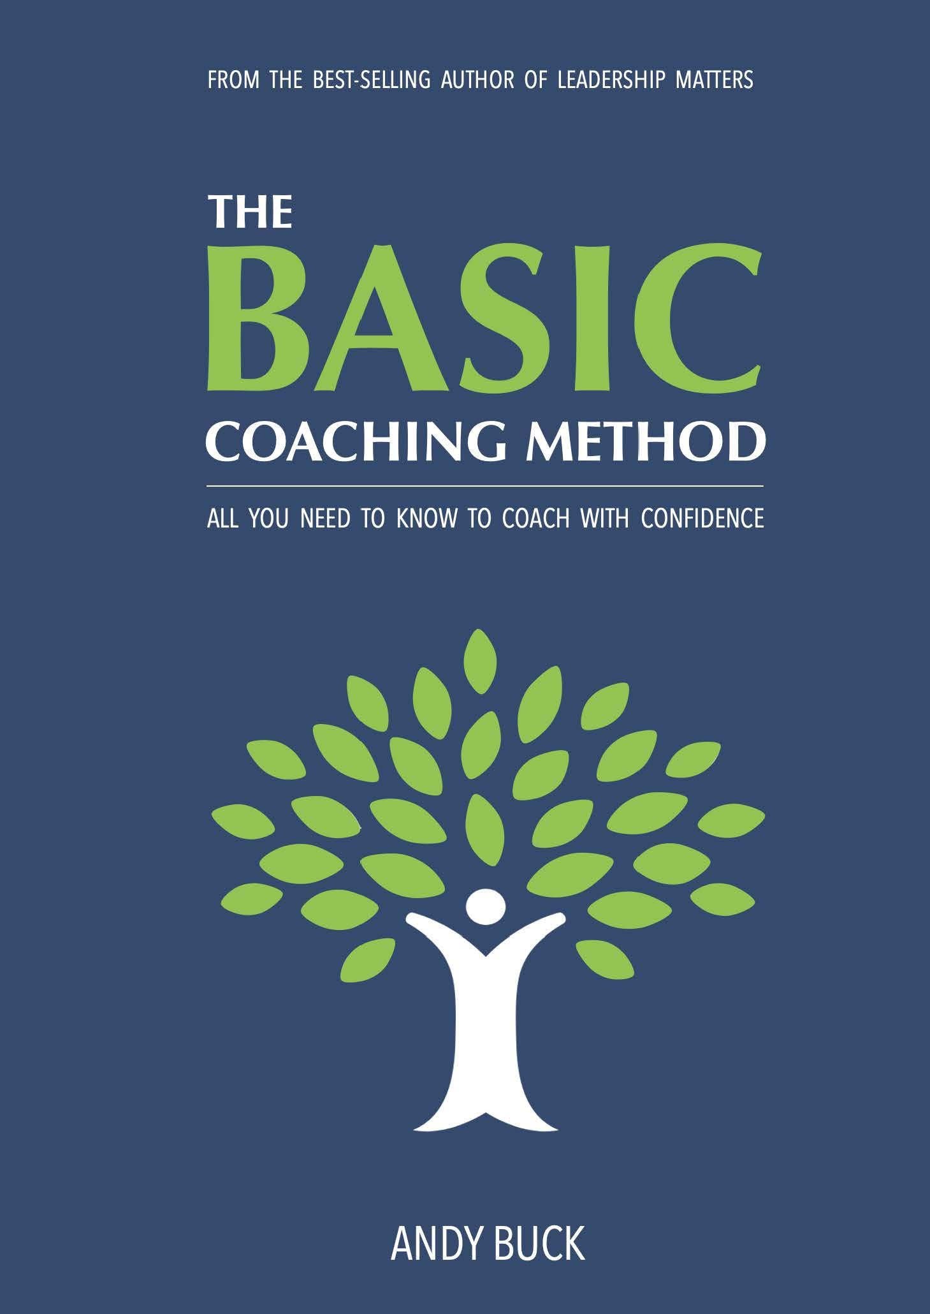
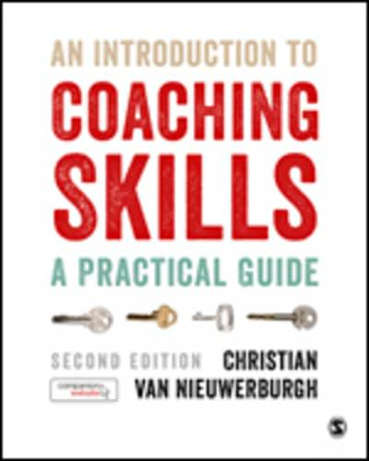
CollectiveED – The Centre for Mentoring Coaching and Professional Learning – vast bank of resources
Growth Coaching International –case studies on making it work

Slide 9
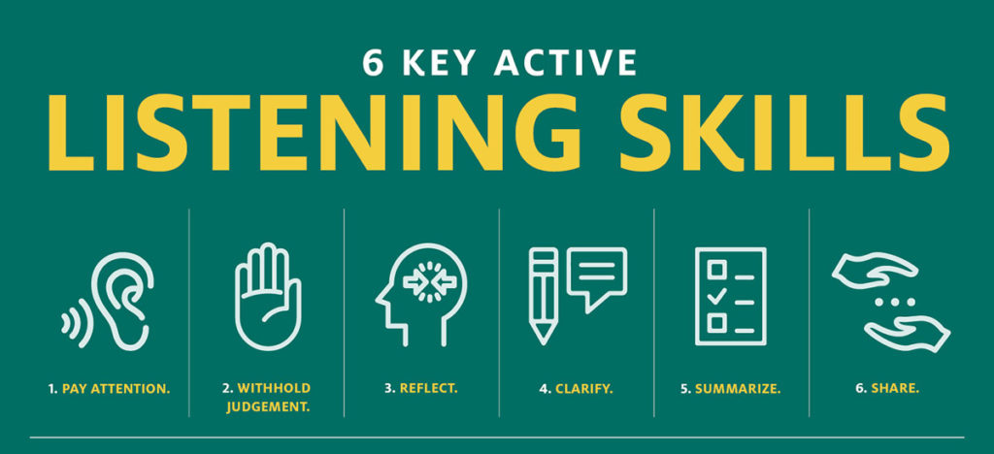
Effective Listening

Slide 10
Effective listening
Eye Contact
Facial expression
Posture – when do you fidget?
Sounds
Voice Volume
Stay quiet – manage the silence
Match the energy
Who is actively listening?
How do you know?
What is their body language?
Who leans in?
Who looks around?
Who is doing something else during the conversation?

Slide 11
Avoid!
Jumping in too soon – if they are silent, you may well have asked a challenging question that has made them think – let them!
Complete their sentence…Let them struggle to find the right words, don’t try and guess what they want to say
Guess difficult words – even if they change the word, it can be worth unpicking why…
Comparing ourselves – keep the focus on the coachee
Competition
Doodling

Slide 12
Effective Questions
Intent – do you want clarity? An opportunity for them to think things through? Do you want information?
Change Why? to What?
Avoid leading questions

Slide 13
From “Why” to “What”
What barriers do you face with the assessment deadlines? What makes it difficult for you?
Talk to me about the situation with the parent yesterday? What made the situation challenging?
Tell me your thoughts on the feedback policy?
Can you talk me through the conversation with Mrs Y yesterday?
Why are you finding keeping to assessment deadlines difficult?
Why did you get into a difficult conversation with the parent?
Why are you not following our feedback policy?
Why did you respond in that way to that member of staff?

Slide 14
From Coaching to Self Evaluation and Professional Review
School Development
Subject Self Evaluation
Professional Review
It starts with self
Which build into teams
Which creates the school approach
Each of these has to be effective, accurate and robust

Slide 15

Professional Review (not performance management)
Open and transparent
Typicality
Published questions
Career Development Pathways
Be Curious
What Evidence is there?
No Ceiling
Solid Floor

Slide 16
Self Evaluation
Learning Evaluations
Student work
Student Voice
Outcomes
Subject Self Evaluation Summary per half term

Slide 17

Self Evaluation: Making it accurate and robust
With colleagues in subject
With Line Manager
With other subject teams
Other schools (locality or Trust)
External validation

Slide 18
Making it work
Being human
Being humble
Being respectful
Having integrity
Be curious
“Every successful individual knows that his or her achievement depends on a community of people working together”
Paul Ryan

Slide 19
Making it work
… is one where coaching is the predominant style of managing and working together
Where a commitment to grow the organisation is embedded in a parallel commitment to grow the people within the organisation
Van Nieuwerburgh
(2018)

Slide 20

Any Questions?

